Slide 1
Coursera Capstone
IBM Applied Data Science Capstone
Car Collision – All Years
By: Tanmay Pathak
October 2020

Slide 2
Business Problem
In an effort to reduce the frequency of car collisions in a community, an algorithm must be developed to predict the severity of an accident given the current weather, road and visibility conditions.
When conditions are bad, this model will alert drivers to remind them to be more careful.

Slide 3
Data Understanding
Data of road accidents recorded by Traffic Records.
This includes all types of collisions. Collisions will display at the intersection or mid-block of a segment. Timeframe: 2004 to Present.
Our predictor or target variable will be 'SEVERITYCODE' because it is used measure the severity of an accident from 0 to 5 within the dataset. Attributes used to weigh the severity of an accident are 'WEATHER', 'ROADCOND' and 'LIGHTCOND'.
0 : Little to no Probability (Clear Conditions)
1 : Very Low Probability - Chance or Property Damage
2 : Low Probability - Chance of Injury
3 : Mild Probability - Chance of Serious Injury
4 : High Probability - Chance of Fatality

Slide 4
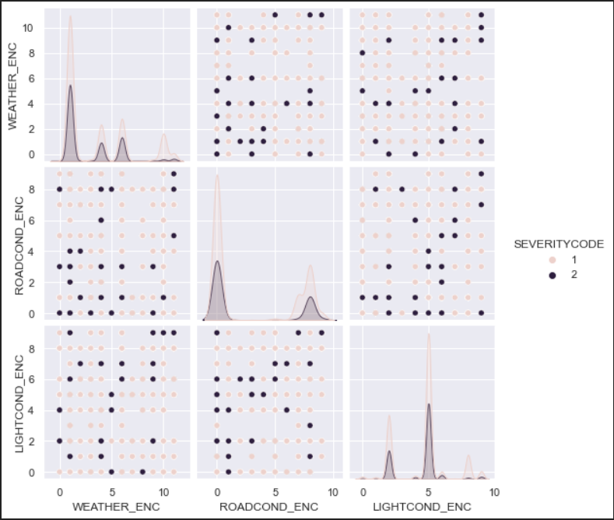
Data Visualization

Slide 5
Methodology
Filtering the data which contains SEVERITYCODE, WEATHER, ROADCOND, LIGHTCOND
After Processing the dataset & encode the dataset for model evaluation.
KNN Supervised Clustering will be used to make distribution between SEVERITYCODE level
i.e 0, 1, 2, 3, 4, 5

Slide 6
Result
The Accuracy of KNN Model for 5 Neighbors : 69%

Slide 7
Conclusion
Based on historical data from weather conditions pointing to certain classes, we can conclude that particular weather conditions have a somewhat impact on whether or not travel could result in property damage (class 1) or injury (class 2).

